Slide 1
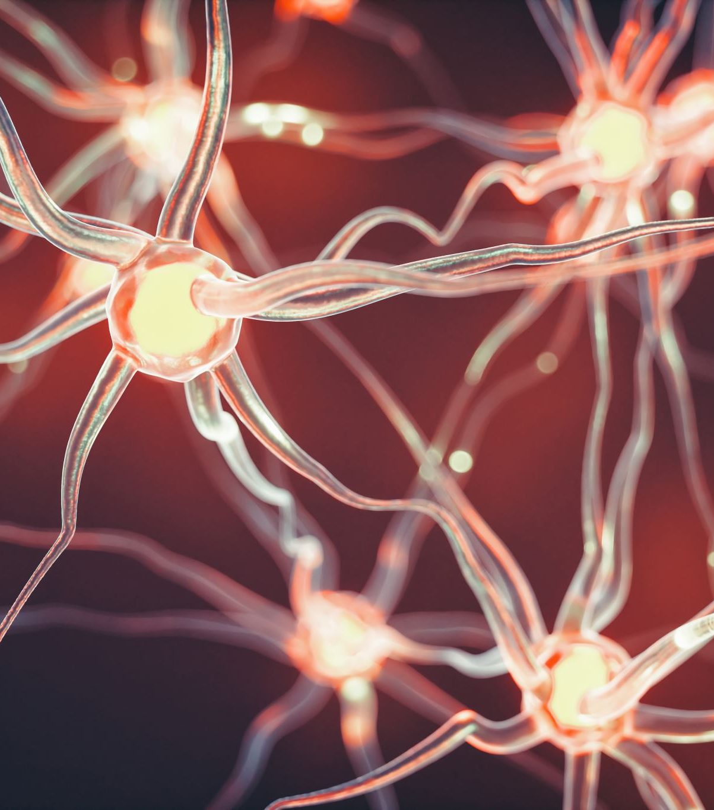
Effects of semantic associations and reward on hippocampal transitive inference processes
Florian Leprévost
Prof. Dr. Bianca Wittmann
Justus-Liebig-Universität Gießen –
BION meeting 2022

Slide 2
1.1 Associative Inference
1. Introduction
A
B
A
C
B
C
Notes:
What is AI

Slide 3
1.1 Associative Inference
1. Introduction
State representation
OFC (Spalding 18, Jones 12)
OFC-hippocampus (Bowman)
Value computation
Striatum & VTA dopamine (RL)
Generalisation
OFC hippocampus (Schlichting 16)
Striatum- hippo FC (Wimmer 12)
Dopamine to MTL? (Kahnt 16)
Semantic association (Ryan et al., 2016)
Facilitates associative learning
And intact in hippocampus lesion
HPC
(associated) state computation
associated value computation
OFC
St
generalisation?
reinforcement learning
VTA
Notes:
what processes/areas involved

Slide 4

How does semantic memory facilitate associative learning?

Slide 5
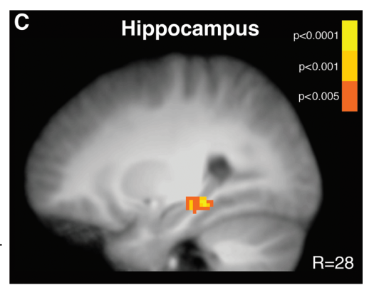
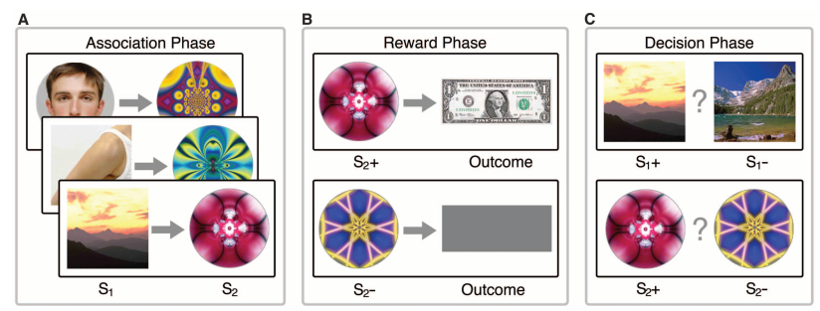
1.2 Paradigm
1. Introduction
Hippocampus activation during learning (A-B) predicts associative performance (in probe phase)
Wimmer & Shohamy 2012
Pre-conditioning Conditioning Probe
Less hippocampal involvement necessary for semantically linked pairs
Notes:
Example of xp based on this

Slide 6
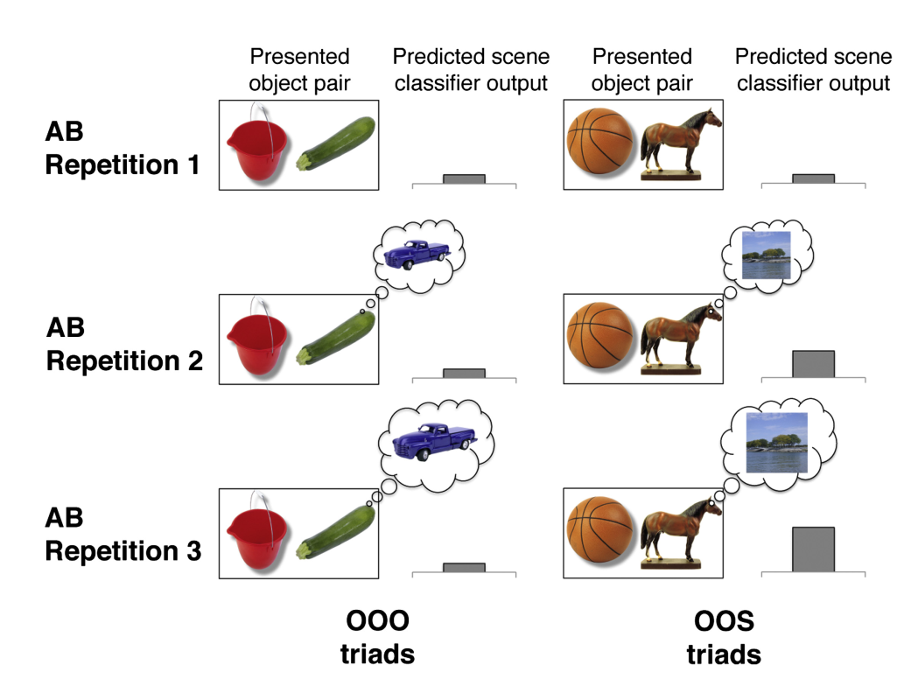
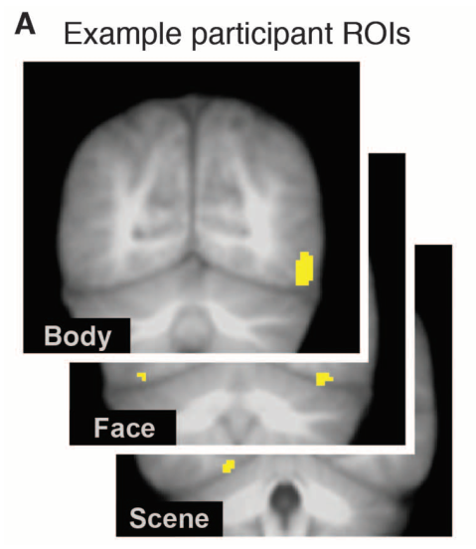
1.2 Paradigm
1. Introduction
Category specific visual areas
Train category classifier
Earlier greater classifier output for semantically linked objects

Slide 7
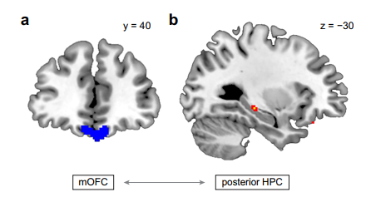
1.2 Paradigm
1. Introduction
OFC-hippo FC correls with reaction times during Probe phase (Wang)
Striatum- hippo FC during Conditioning phase correls with performance in Probe Phase (Wimmer)
Less hippocampal-OFC (and hippo-striatum) functional connectivity necessary for semantically linked pair

Slide 8
1. Introduction
1.3 Hypotheses
Hippocampal activity and connectivity reduced and unrelated to performance for semantically linked pairs
Reactivation of the associated stim in ealier repetition for the semantically linked pairs
+ candidates for semantic facilitation = IFG, entorhinal cortex, PCC

Slide 9

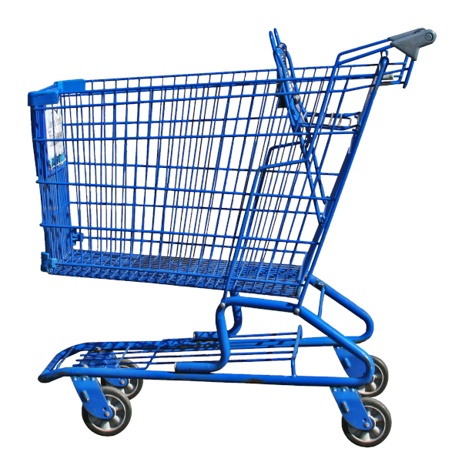

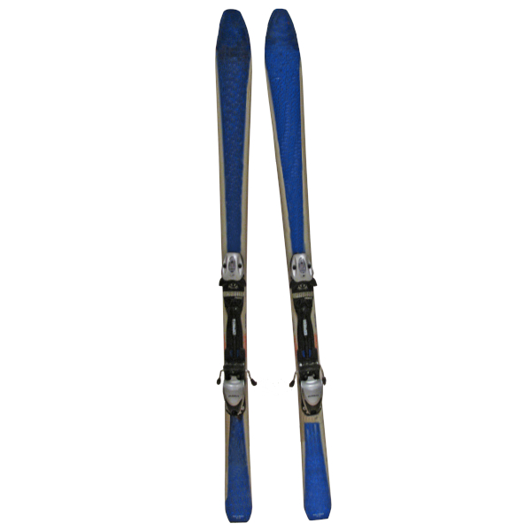

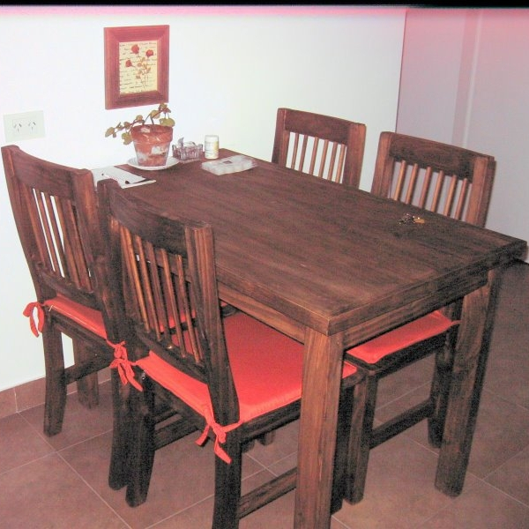

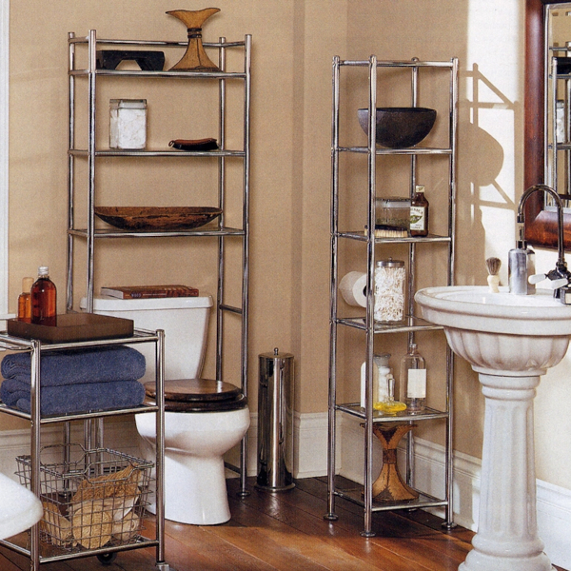
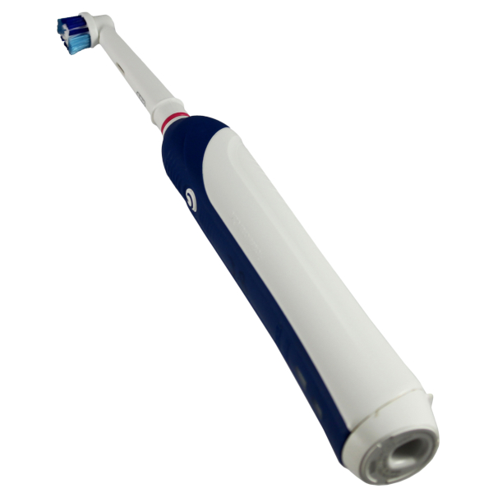

2.1 Design
2. Experiment
Semantic link
0 1
2 x 2
Semantic link
Reward
4 pairs of each = 16
Balanced
0
Reward
1

Slide 10
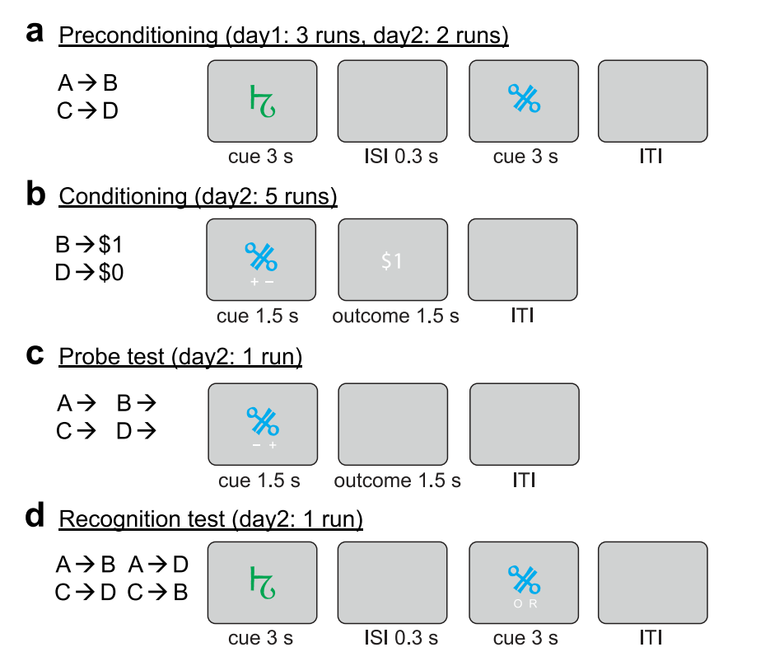
2.1 Design
2. Experiment
Pre-conditioning
Conditioning
Probe
Localizer/ Distractor (avoid recency effects)
Memory
+ -
+ -

Slide 11

2. Experiment
2.2 Time course
Preconditioning
16 S-O pairs, 6 runs
Conditioning
16 O-R pairs, 6 runs
Localizer Distractor task
N-1 task 8 blocks of 13stims
Probe
32 single images, 2 runs
Memory
32 S-O pairs, ½ new, ½ old
~ 7 min
S 1,5s + ISI 1s + O 1,5s + ITI 2,5s
~ 7 min
O 1,5s + ISI 1s + R 1,5s + ITI 2s
~ 6 min
0,3s ITI + 2s stim
~ 6 min
S1 1,5s + ISI 1s + O 1,5s + ITI 2s
~ 4 min
SO 2,5s + ITI 2s

Slide 12
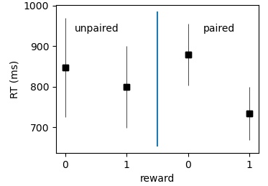
2. Experiment
2.3 Preliminary behavioral results
Semantic facilitation
n=4
Probe phase

Slide 13
3. fMRI
3.1 Functional Sequence
nb of slices = 50
Slice thickness = 3mm
TE = 30ms
TR = 2,8s
voxel size = 3x3x3mm
iPAT grappa 2 factor
Additional fieldmap
Standard T1
Midbrain MT sequence

Slide 14
3. fMRI
3.2 Preparation
Common Regressors
Semantic (2)
Run nb (6)
Phase specific regressors
Precond : state/categ (scene or object)
Cond/Inference : Rewarded (2)
Cond: Reward (capture reward stimulus activity)
Normalisation
Not necessary for Reactivation analysis (partcipant specific)
Used on other analysis

Slide 15
3.3 Reactivation Univariate
3. fMRI
Contrast Scenes – Object from localizer
Create Scenes & Object masks
Average beta values within in each mask,
each phase, category (semantic/reward) and run
Normalize by averafe localizer activity within mask
ANOVA for each phase
6 runs * 2/4 conditions
T-tests to test hypo = more associated classifier outputs for more repetition/ for semantic link

Slide 16
3.4 Reactivation Multivariate (RSA)
3. fMRI
Average evoked activity for Scenes & Object from localizer
In a ventral temporal lobe ROI
Correlate with average evoked activity by phase/run/category
Hypo = correlation with opposite pattern (eg with scene for an object) increase with run/ in semantic condition
Control = same ana on same category patterns
precond scene evoked patterns shouldn’t get more similar to localizer scene evoked patterns across runs
ANOVAs and t-tests

Slide 17
3.5 Hippocampus activity & connectivity
3. fMRI
After normalization, look at activity in hippocampal mask
Averaged by phase/run/category
T-tests : significantly lower for semantic pairs?
Regression : predicts inference performance for non-semantic pairs?
PPI or SEM
See if hippocampal-OFC and hippocampus-striatum connectivity mediated by semantic link, or inference performance

Slide 18
3.6 Other semantic regions involved
3. fMRI
Contrast semantic pairs – non semantic pairs in every phase
Searchlight RSA analysis to identify where similarity higher for semantic pairs

Slide 19
3. Conclusion
Associative inference
Semantic link & Reward
Reactivation analysis
Hippocampal role

